Slide 1
String Builder and String Buffer
StringBuilder and StringBuffer are classes in Java used to create mutable (modifiable) sequences of characters.
Both the classes can change the contents of a string without creating a new object each time.
StringBuilder | StringBuffer
It is not thread-safe | It is Thread-safe (methods are synchronized)
Faster in execution as it is not Synchronized, especially in single-threaded applications. | Due to synchronization overhead, it's generally slower than StringBuilder.
Suitable for Single-threaded environments where performance is priority | Suitable for Multi-threaded environments where data consistency is priority
Note : all the methods in StringBuilder and StringBuffer are similar as they use identical API , only difference lies in synchronization

Slide 2
Common methods for String Builder and Strin buffer
Append | append(String s)
Insert | insert(int offset, String s)
Delete | delete(int start, int end) deleteCharAt(int index)
Replace | replace(int start, int end, String str)
Reverse | reverse()
Character ops | charAt(int index) setCharAt(int index, char c)
Search | indexOf(String str) indexOf(String str, int fromIndex) lastIndexOf(String str) lastIndexOf(String str, int fromIndex)
Substring / Subsequence | substring(int start) substring(int start, int end) subSequence(int start, int end)
Comparison | compareTo(StringBuffer sb)
Conversion | toString()

Slide 3
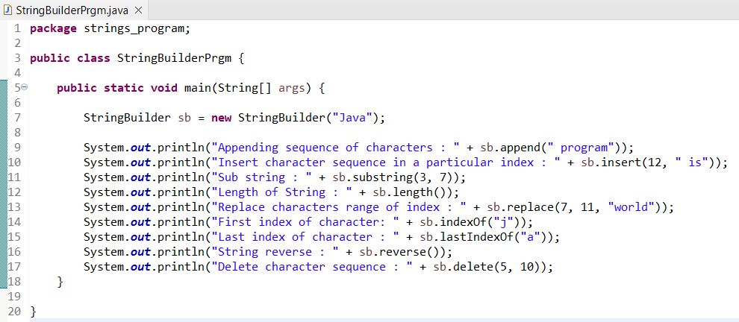
String Builder Example

